Slide 1
Introduction
Ramya Bhargavi Anumula

Slide 2
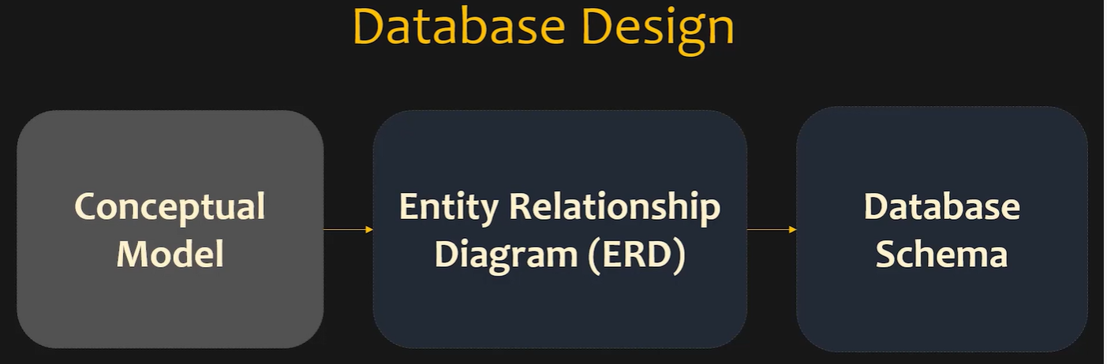
STAGES OF DATA BASE CREATION
Discussing The Requirements
Connecting different requirements and making different tables
Original Schema is built

Slide 3
CONCEPTUAL MODEL

Slide 4
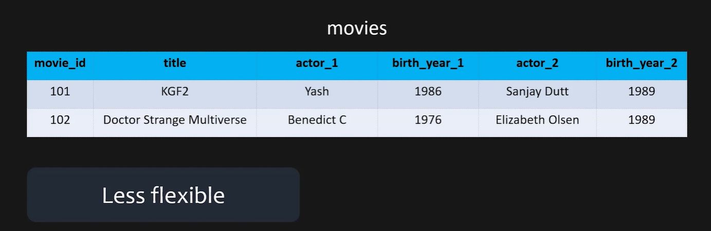

Slide 5
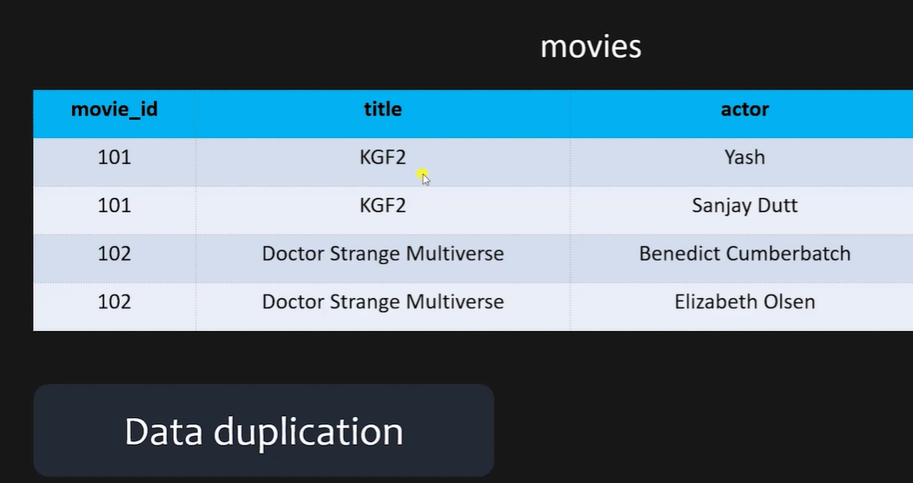

Slide 6
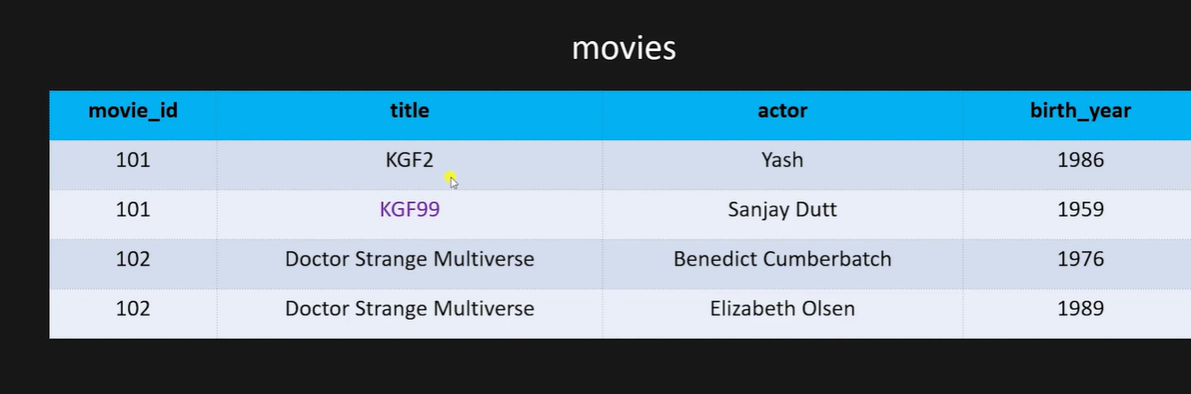
DATA INTEGRITY
Data should be accurate and consistant

Slide 7
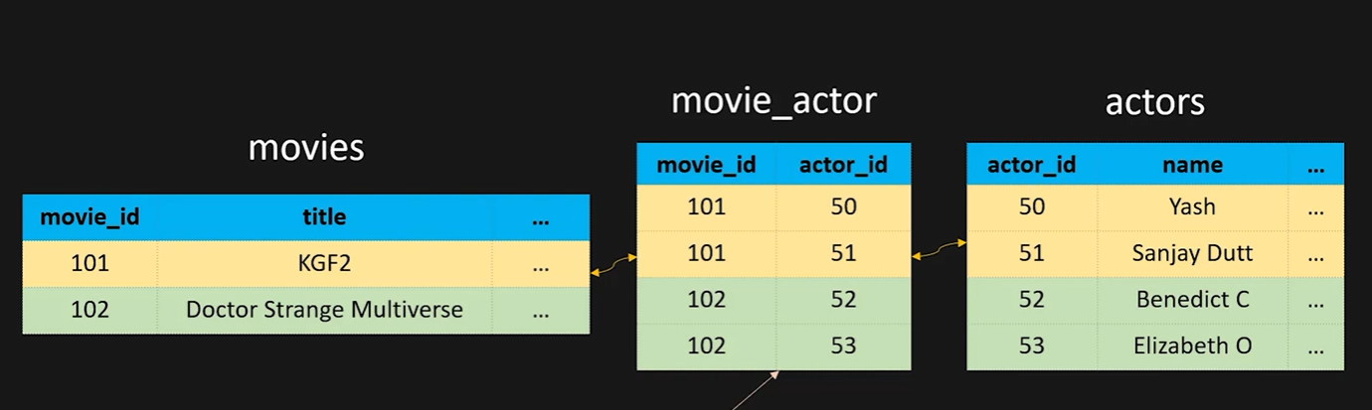


Slide 8
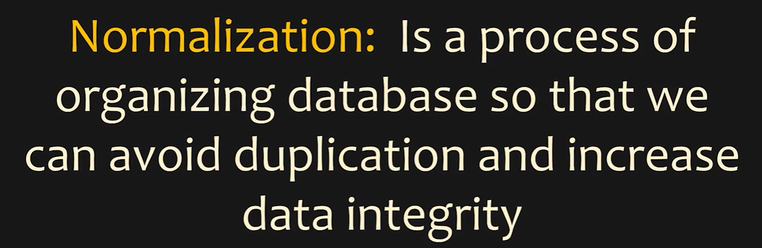


Slide 9
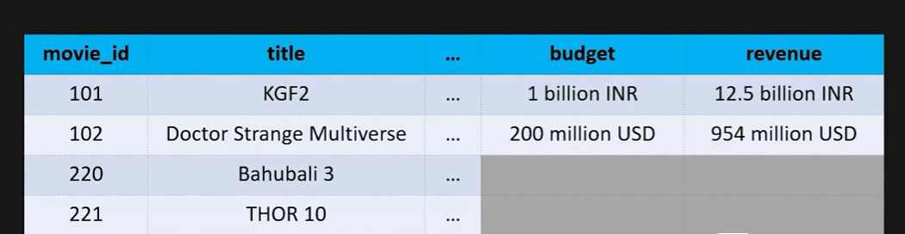
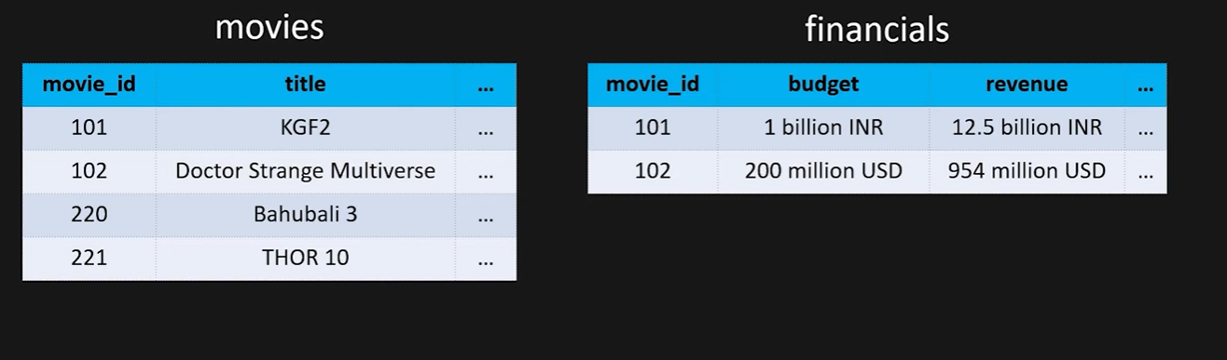

Slide 10
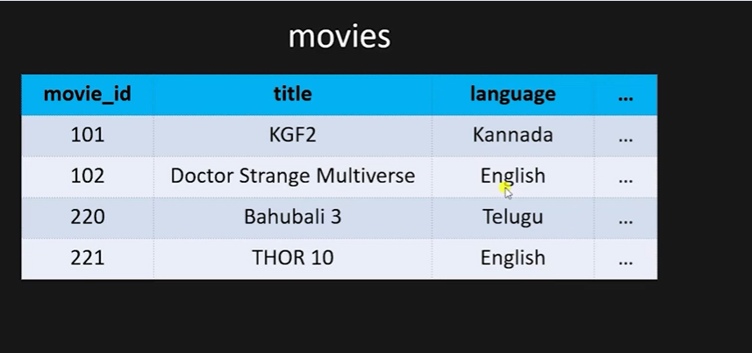
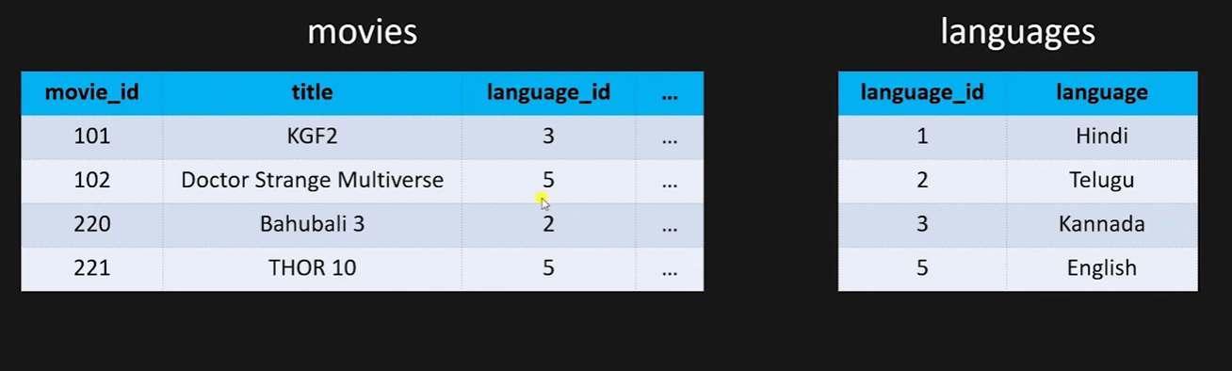

Slide 11
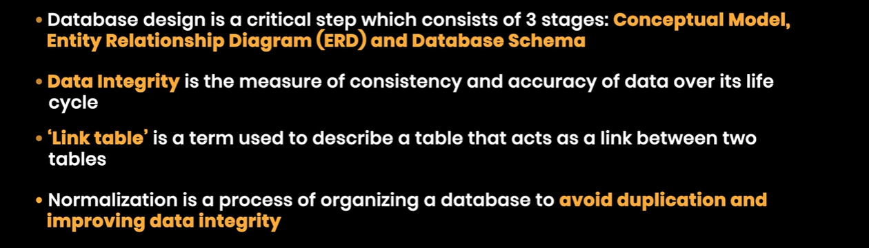

Slide 12
ENTITY RELATIONSHIP DIAGRAM

Slide 13
WE DRAW THEM BASED ON THE USE CASES… SOMETIMES ONLY THE EXCEL SHEET WILL BE GIVEN AND WE WILL HAVE TO DRAW ERD DIAGRAMS.
ERD DIAGRAMS TOOLS
Draw.io
DB.IO
ALSO IN MY WORK BENCH.. We can create ER DIAGRAMS

Slide 14
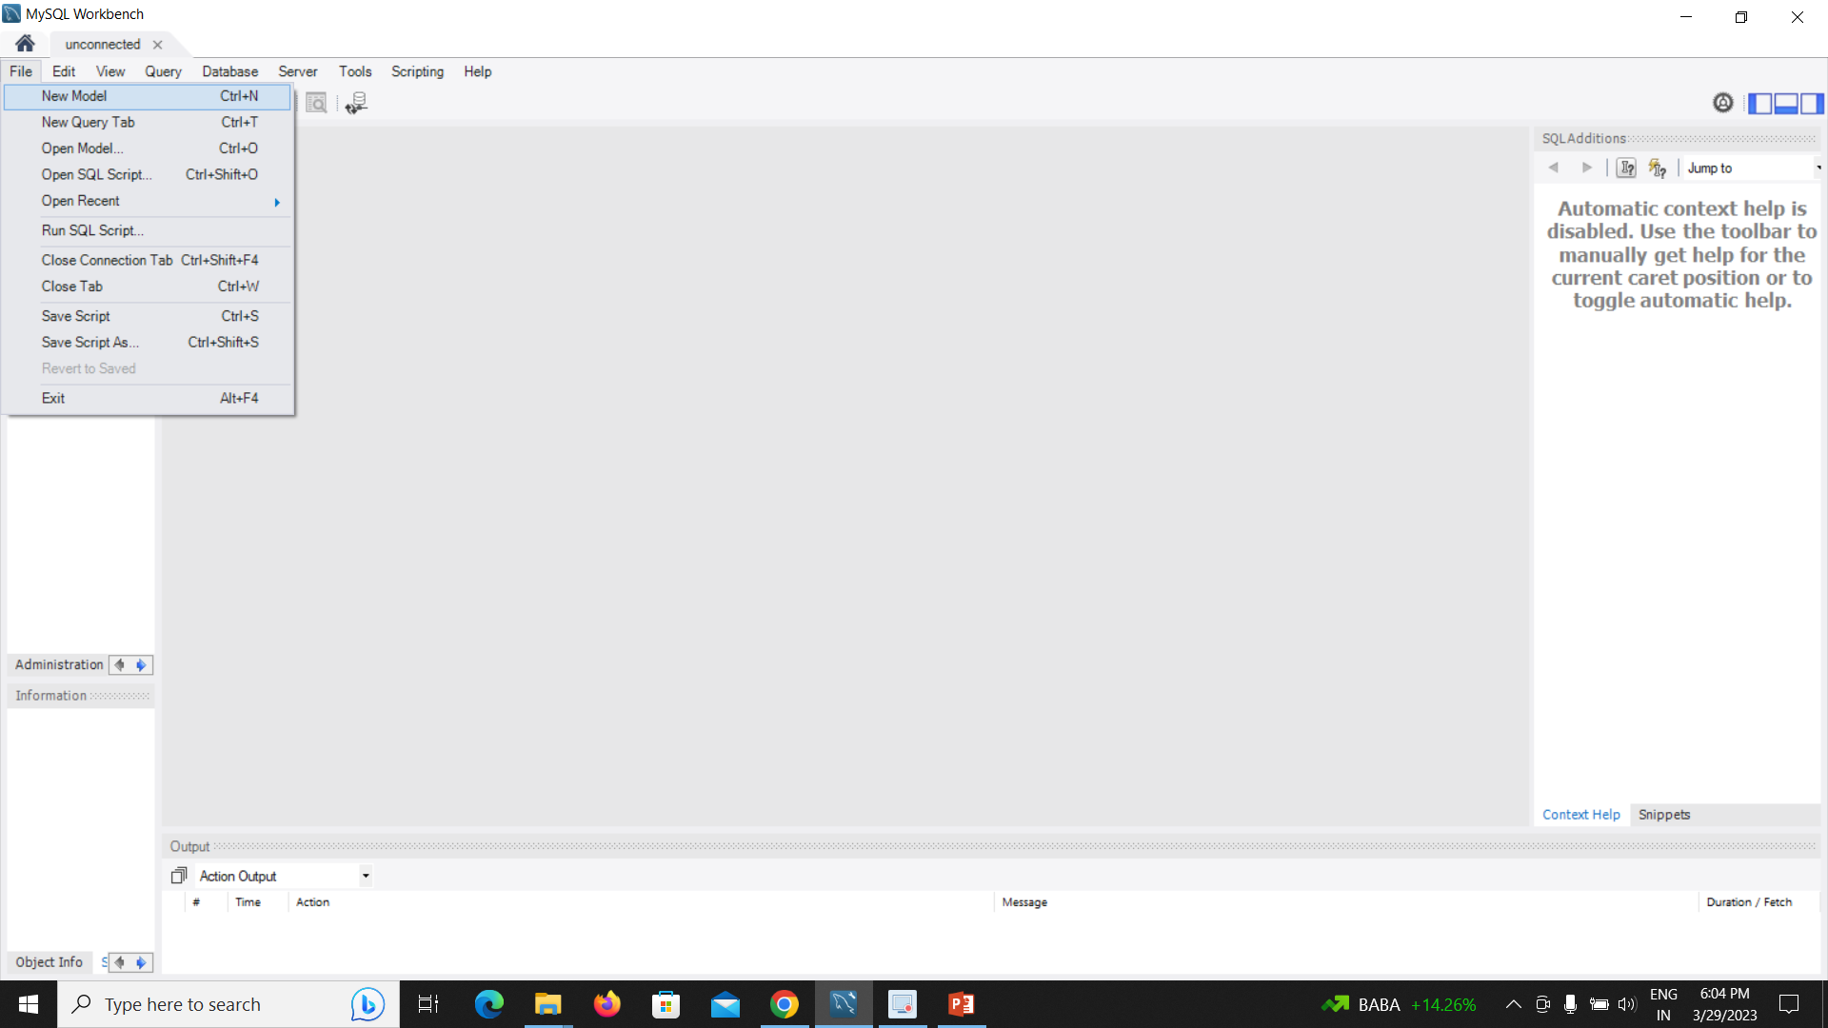

Slide 15
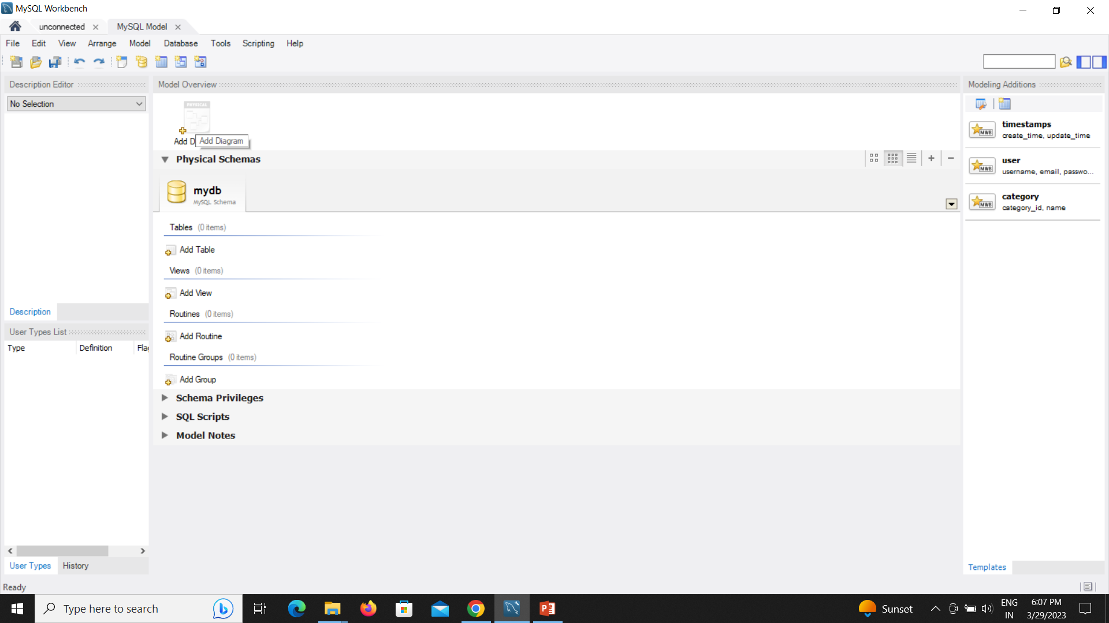

Slide 16
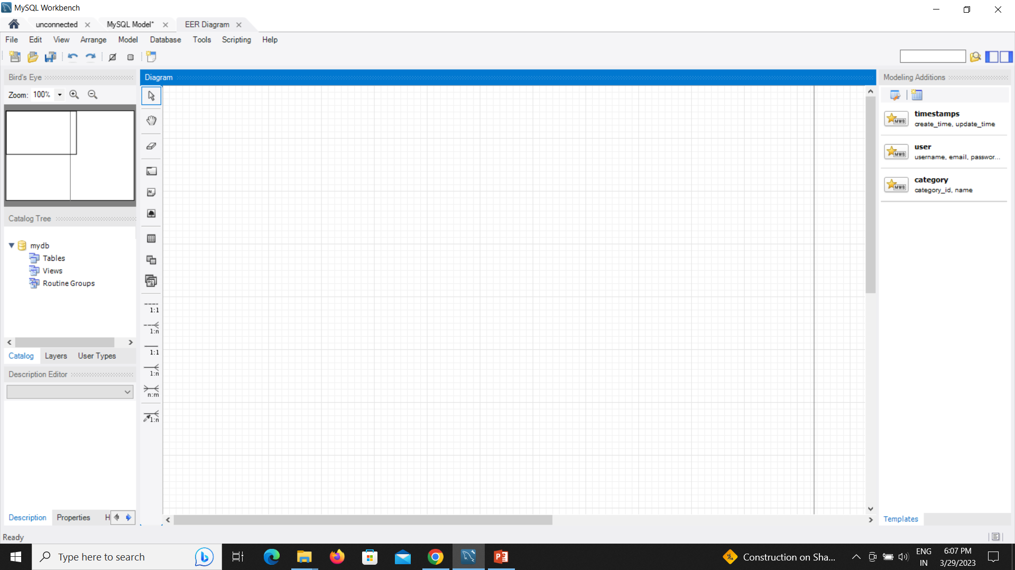

Slide 17
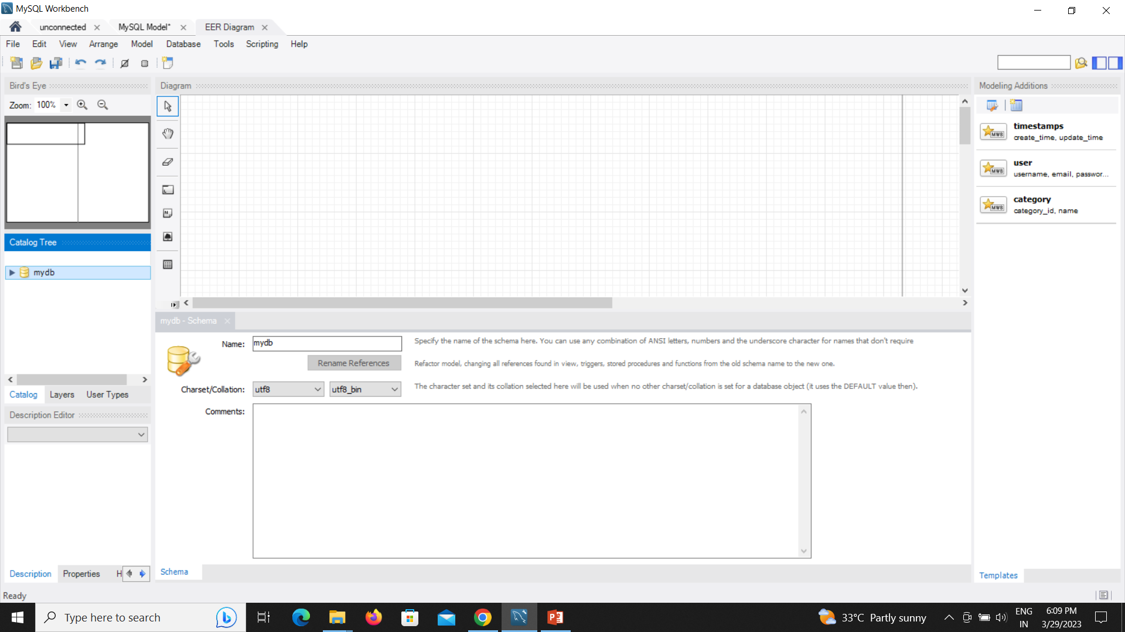

Slide 18
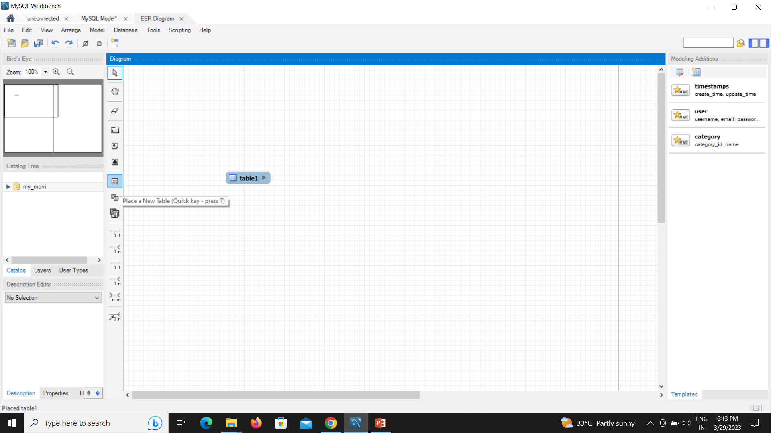

Slide 19
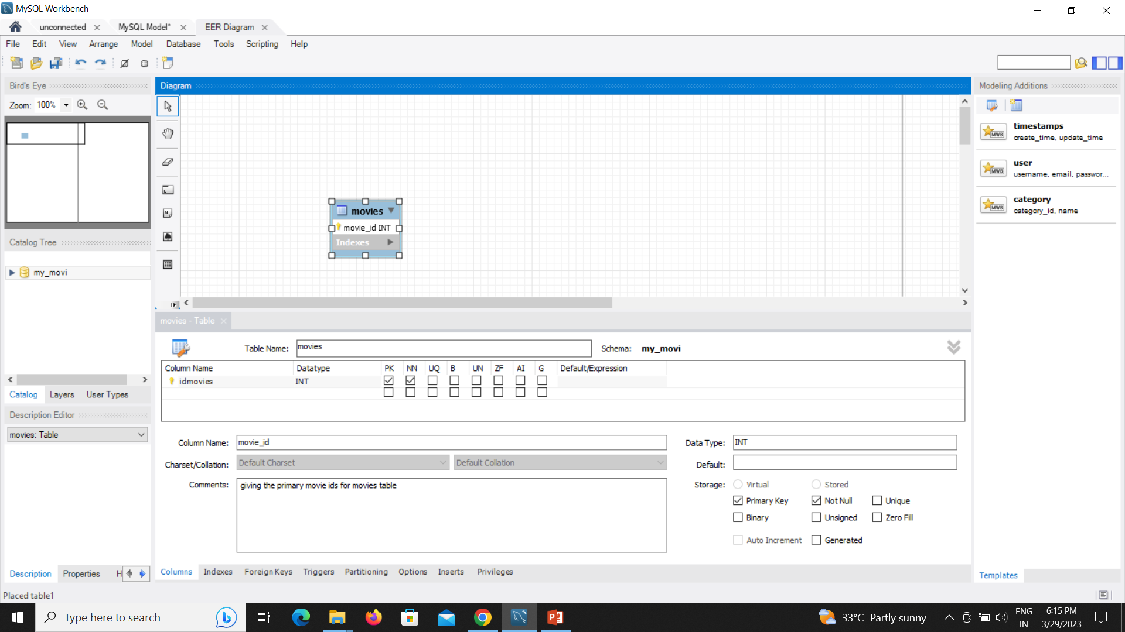

Slide 20
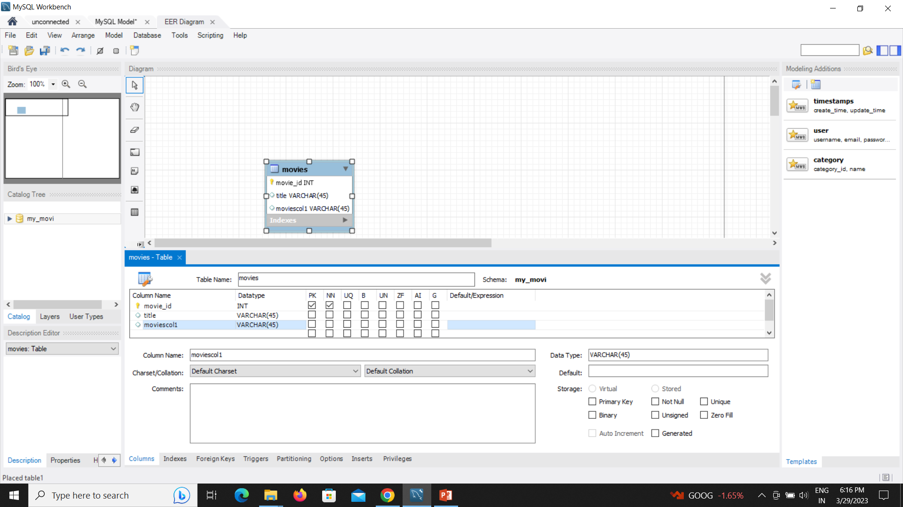

Slide 21
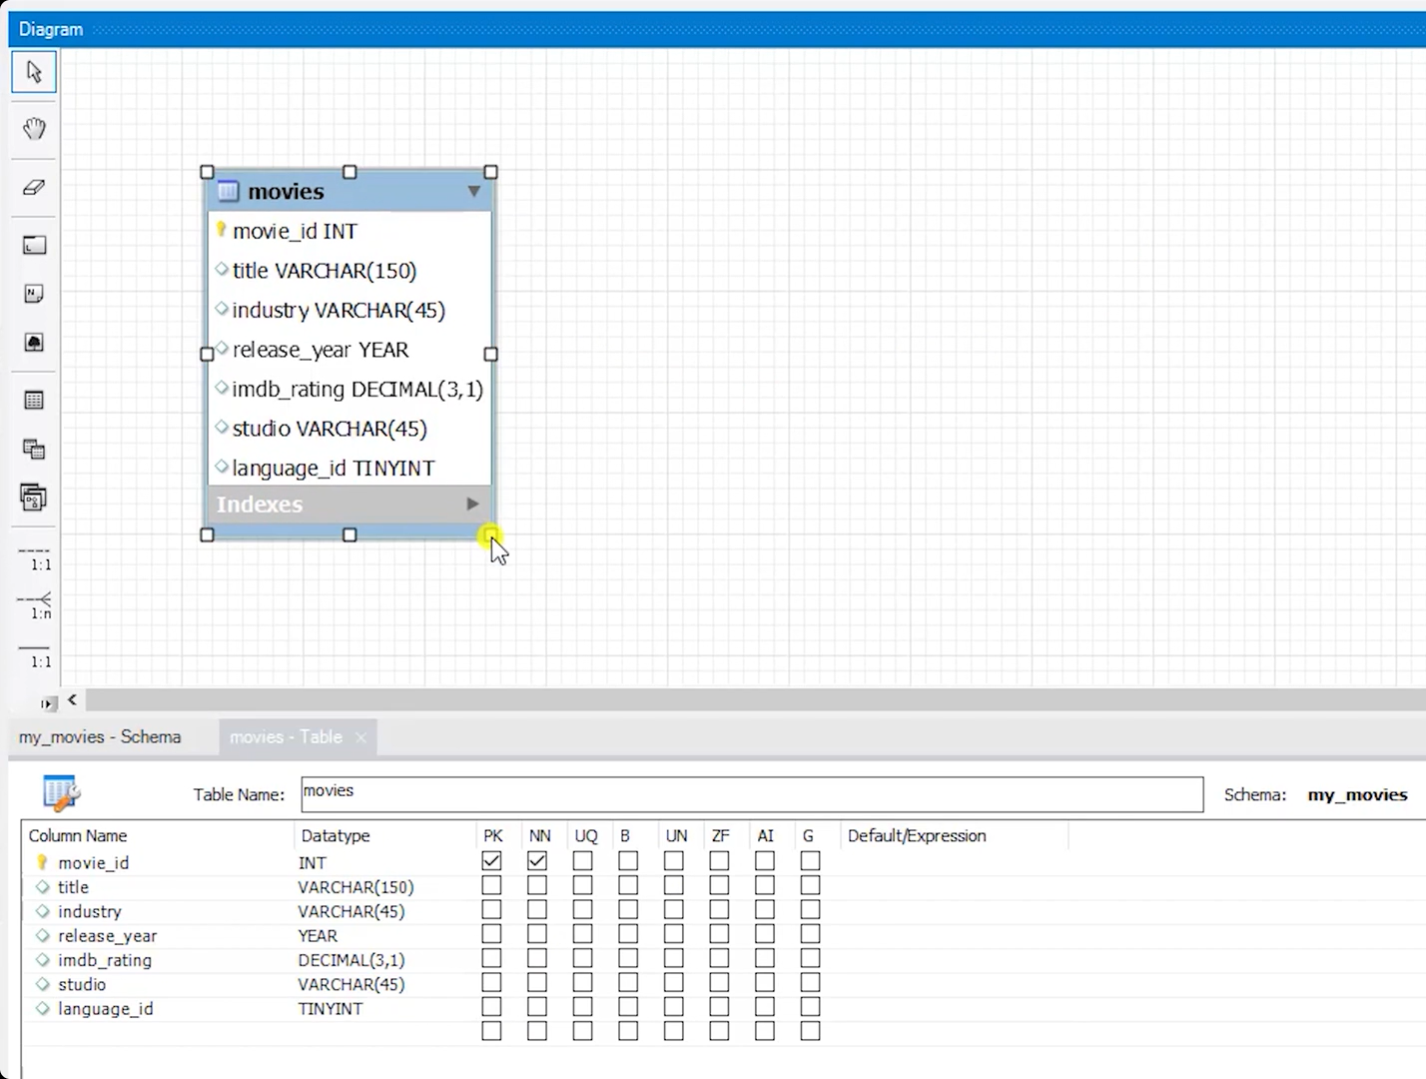

Slide 22
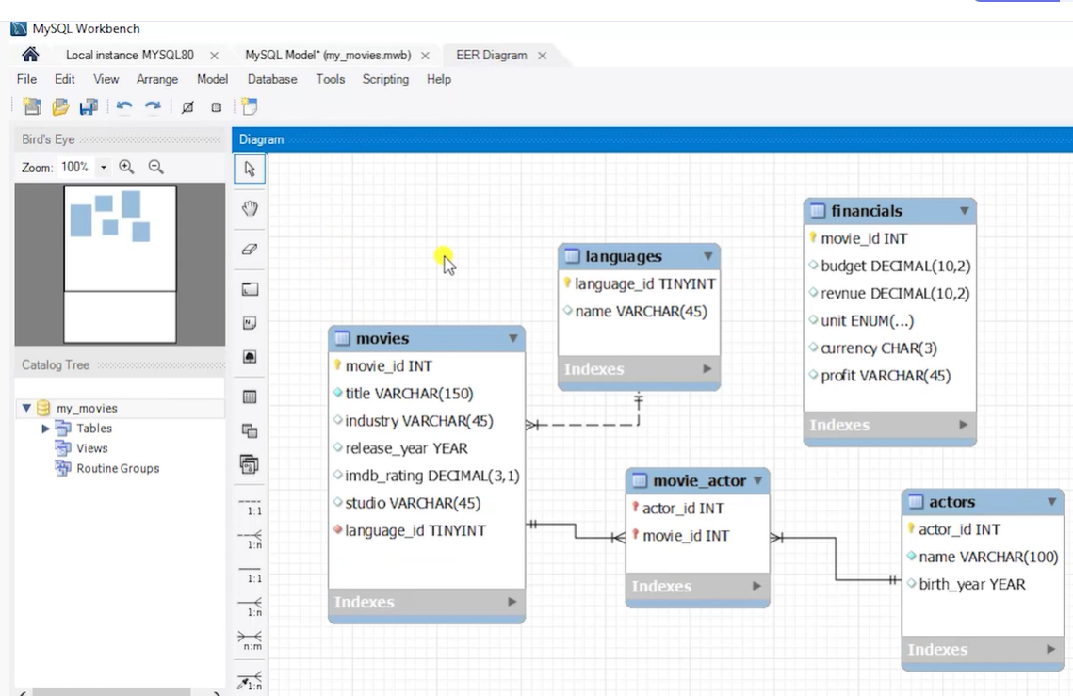

Slide 23
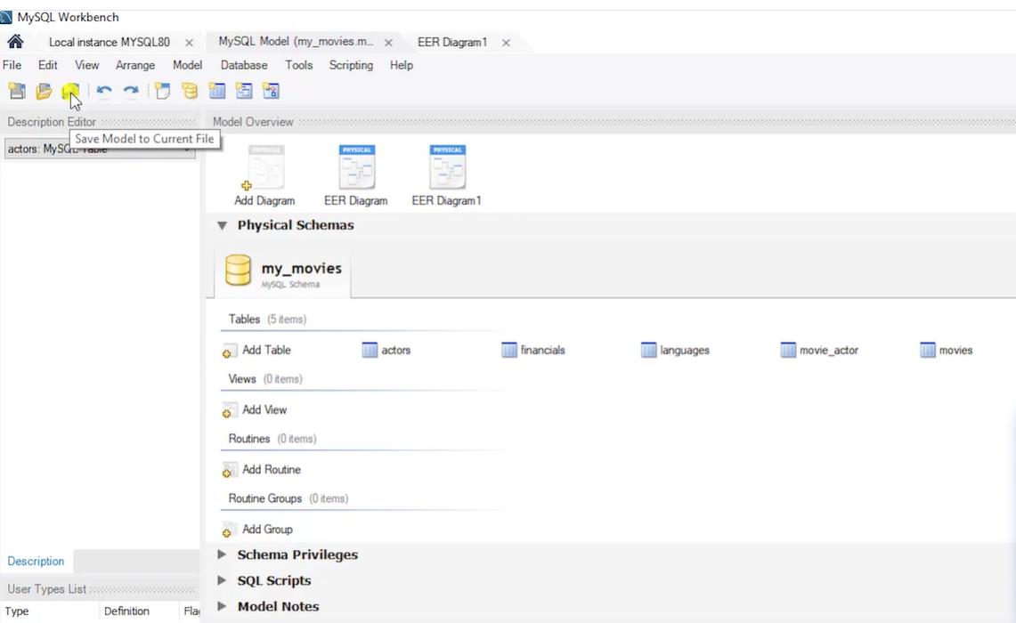

Slide 24
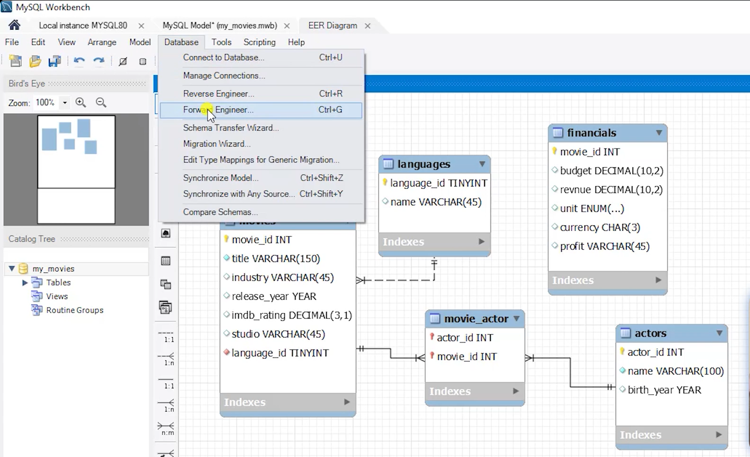

Slide 25
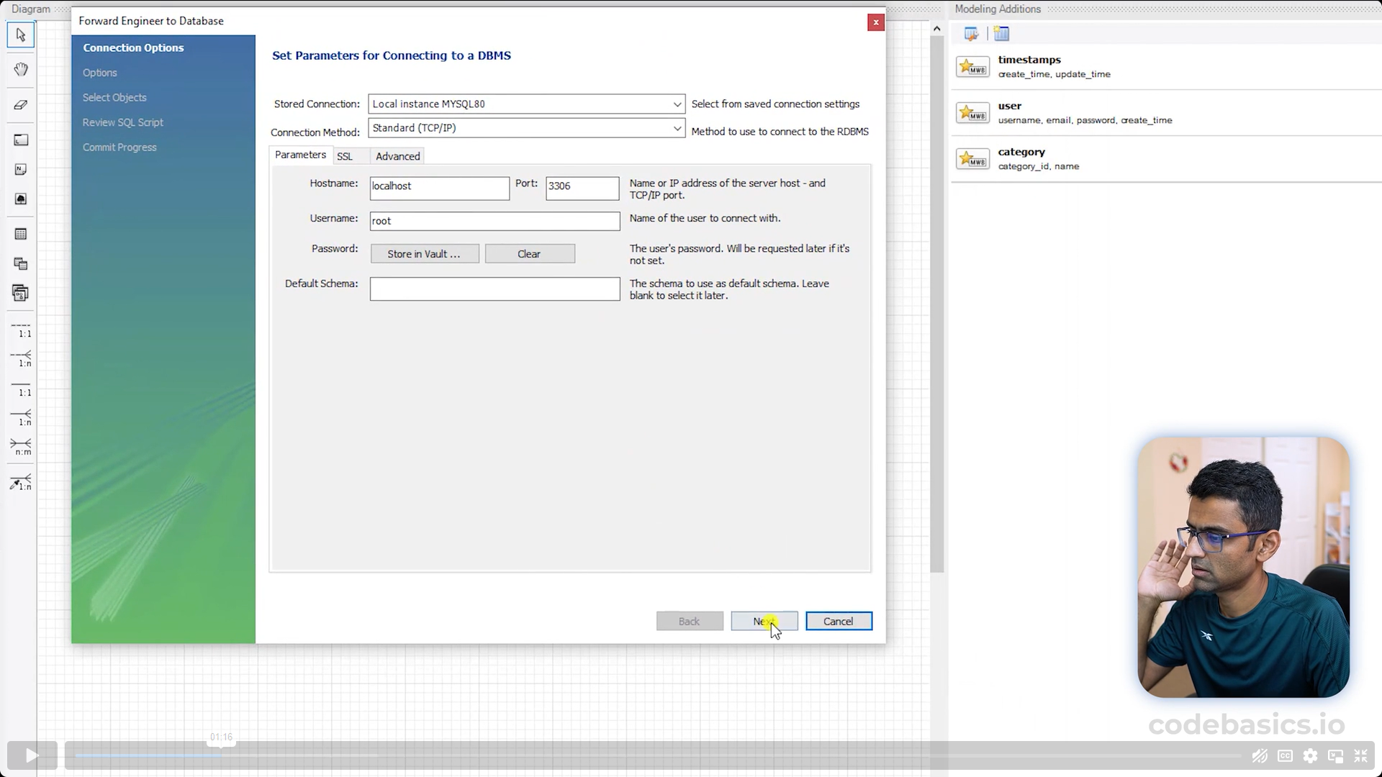

Slide 26
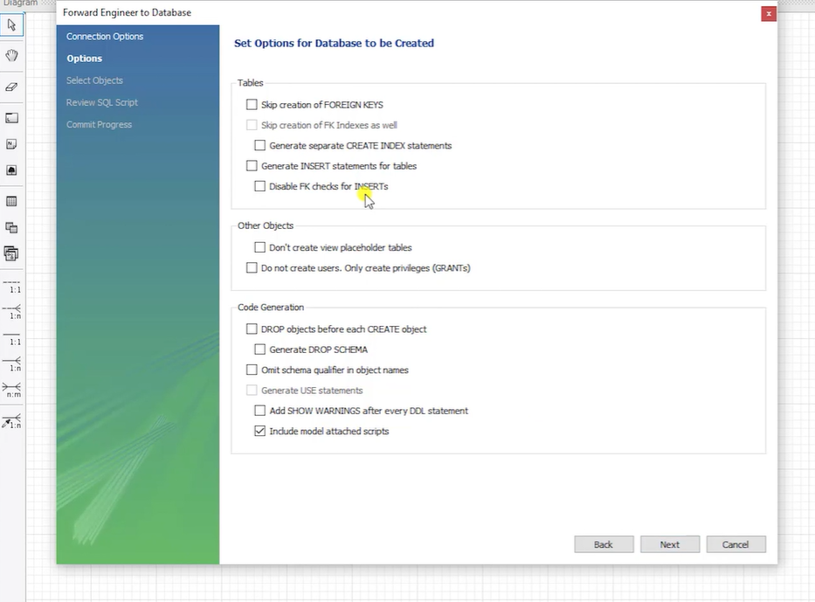

Slide 27
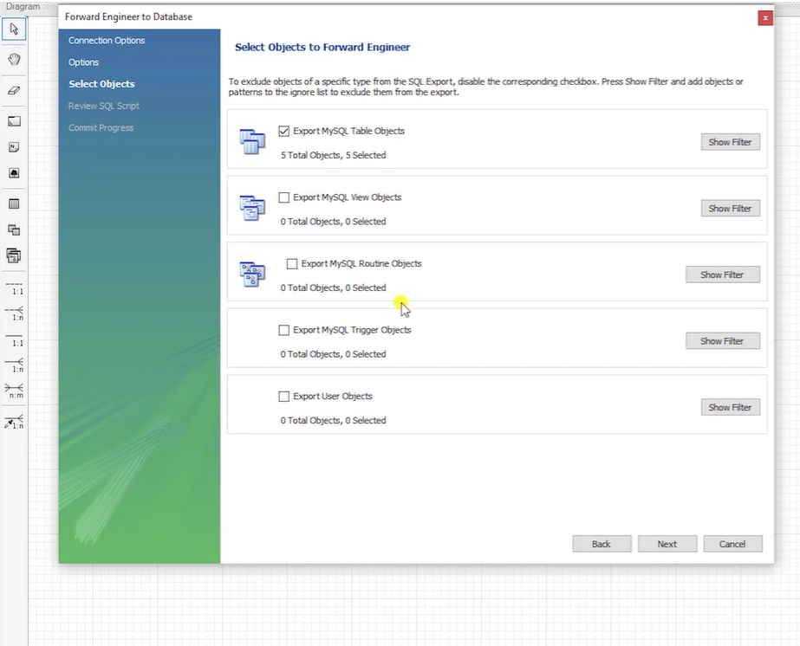

Slide 28
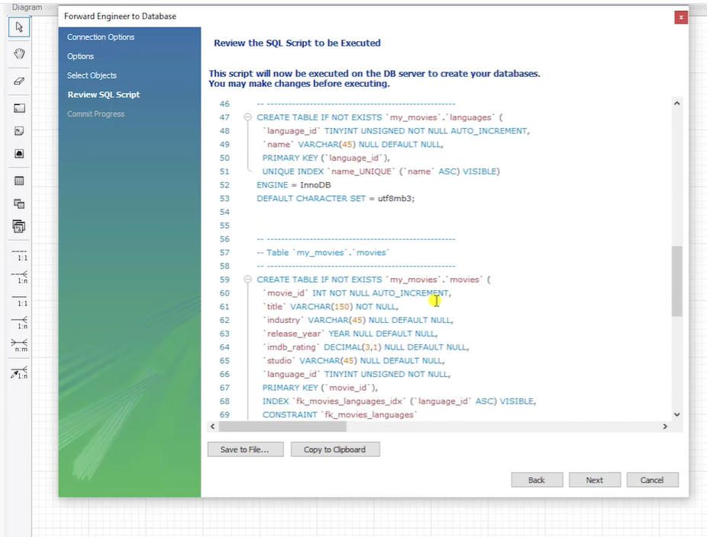

Slide 29
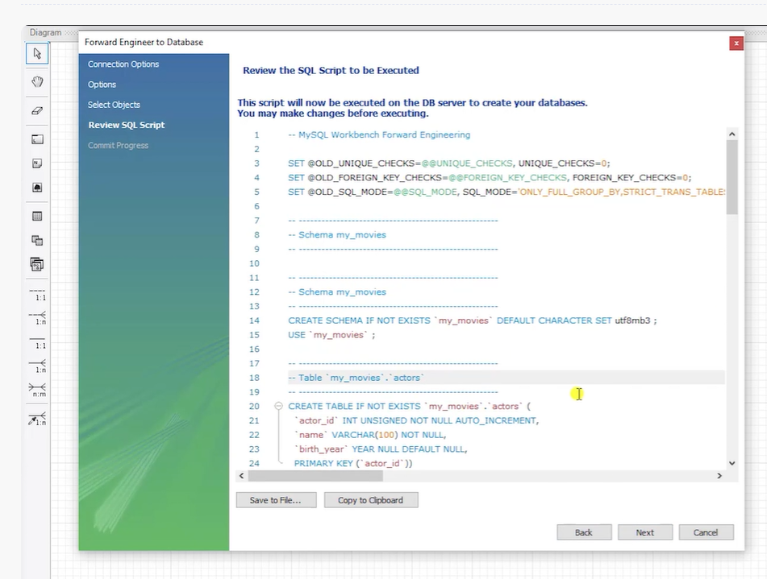

Slide 30
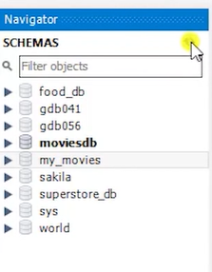

Slide 31
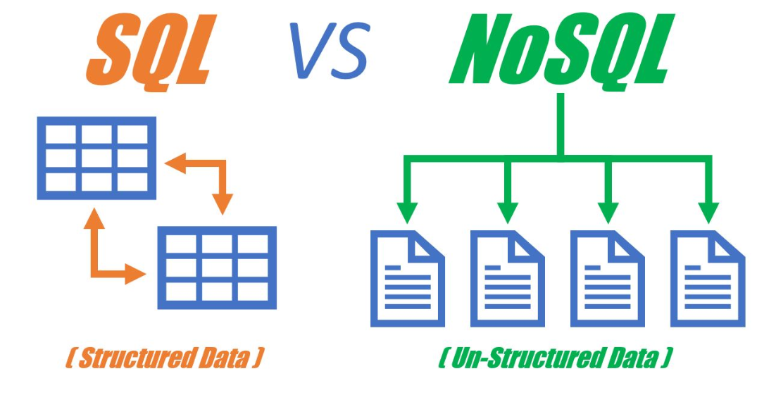







Slide 32
Here we have used different types of data types…. All those different data types we will see in next videos.

